Slide 1
Hotels’Surroundings

Slide 2
INtroduction
Most travel search engines allow the user to search for hotels based on
Travel dates
Price
Sometimes the user is more interested in the venues around the hotel
Study Objective: Show there is a market for accessibility based search engines based on a hypothetical case of a user

Slide 3
INtroduction
Case Study
hypothetical user is looking for a hotel in Montreal with Since his company is paying for the stay, he is not very concerned about the price, he is more concerned about the hotel surroundings. He is looking for the following three features:
Easy access to metro station (within a 500m radius)
At least a grocery store (within 500m radius)
At least a post office (within a 300m radius)

Slide 4
Data
Single source: Foursquares
4 searches:
Hotels
Groceries
Metro stations
Post Office
A single data base be built
All the listed hotels in an 8 km radius from downtown Montreal
A variable indicating if there is a grocery store near hotel
A variable indicating if there is a metro station near hotel
Variable indicating if there is a post office near hotel

Slide 5
Methodology
Import Required Libraries
Extract data
Build main data frame:
Based on distances calculated using Pythagoras
K-means to classify hotels in 5 groups
Create grades based on clusters
Clusters don't respect user preference, so we need to evaluate which ratings are best for the user)
Create a color-coded map, to show in green the best hotels and in red the worse hotels to the user

Slide 6
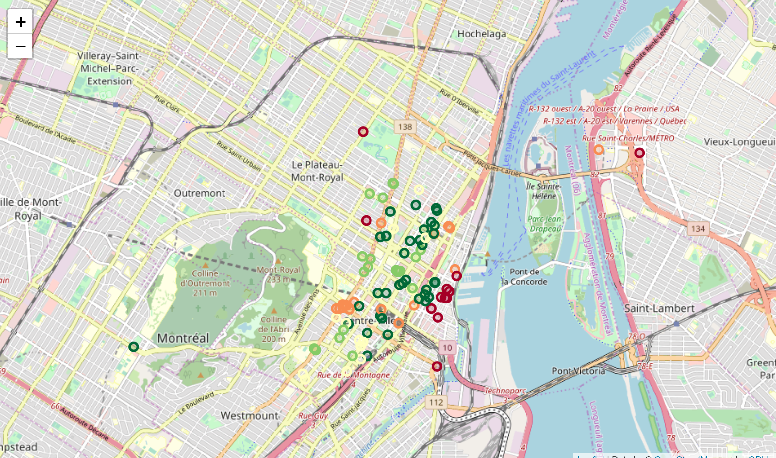
Results

Slide 7
Discussion
With easily available data on Foursquares it is possible to:
Build a simple app to classify hotel based on user’s preference
App based in a machine learning algorithm
App can still be improved
Show less green values
Study shows that there is a potential for accessibility based search engines

Slide 8
Conclusion
It is possible to enhance travel search engines so that the surroundings of hotel can be evaluated while choosing it.
A clustering algorithm was used to classify all hotels in a 8km radius from Downtown Montreal based on three criteria determined by a hypothetical user.

